Slide 1
Diversity Practitioners versus Inclusion Specialists
Future-proofing Diversity of Thought in the Workplace

Slide 2
Acknowledgment to Country
Kaya!
I would like to acknowledge the traditional custodians of the land on which we meet today, the Ngunnawal People, and pay my respects to their Elders past and present. I ask our Spirit People to watch over us here today as we yarn together in this Katitjin Place.

Slide 3
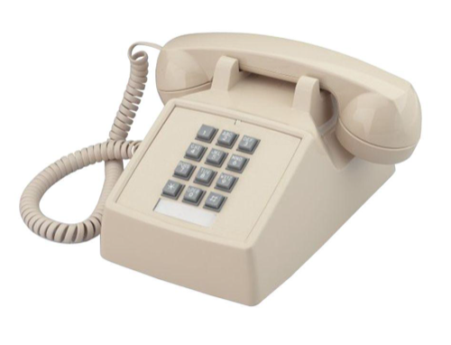
Diversity Practitioners

Slide 4
Diversity in the Workplace
Different is now special ….. or we don’t acknowledge it!
Funding for Diversity initiatives for localised positions
Special events and Days – Harmony Day, Wear Purple Day etc.
Diversity is measured as a set of data, targets and quotas
Social Corporate Responsibility and reputational influence counts which leads to Box Ticking

Slide 5
Diversity - Because being “Different” ticks a box
Diversity On-Demand
Rent-A-Minority is a revolutionary new service designed for those oh-shit moments where you've realised your award show, corporate brochure, conference panel is entirely composed of white men. For, like, the fifth year in a row. Suddenly you're being called out on Twitter and you need to look not-racist and not-misogynist fast. Actually doing something meaningful to disrupt institutional inequality would be way too much work; so why not just Rent-A-Minority instead?

Slide 10
Key Drivers
Global Subject Matter Expertise
Less focus on Technical Competency and more Specialist Intercultural Communication competency
Artificial Intelligence
Virtual Teaming
Globalised Consultancy
Virtualised Project Teaming
Globalised marketing

Slide 11
The Change
Cultural Diversity becomes “Cultural-Add”
The Diversity Dividend becomes a productivity driver
Inclusion becomes a “key driver”
Equality is a Key Job-satisfaction Expectation
Workplaces will be uber-ised – How many “Likes” can we get?
Employees will be uber-ised – Ratings based on Inclusiveness and Agility

Slide 12
The Inclusion Specialist

