Slide 1
four Pillars of culture

Slide 2
addING value to the mission of SIETAR AUSTRALIA
PURPOSE
Demystifying the concept of culture
Celebrating everyday manifestations of culture
Overcoming threats to these powerful forces

Slide 3
THE 4 PILLARS
Language
Community
Sport
The Arts

Slide 4
LANGUAGE
and its impact on culture & society
Violent scuffles broke out in the Ukrainian Parliament May 2012 – re the bill which would allow official use of Russian language
http://www.telegraph.co.uk/news/worldnews/europe/ukraine/9288953/Brawl-erupts-in-Ukraine-parliament-over-Russian-language-bill.html
Pitt & Swanson Str Classroom experience, the ‘uniquely Australian experience – silo’s v.‘’glue getting people together’

Slide 5
The Geographic & Education Divide
“Trump’s margins in rural and exurban counties were off the charts. For example, in Madison County, an exurban area outside Columbus, Ohio, Mr. Romney’s margin over Mr. Obama was 20.4 percentage points; Mr. Trump’s margin over Mrs. Clinton was 39.8.
In February 2017, Stanley Greenberg, a Democratic pollster and strategist, conducted four postelection focus groups with white voters who had cast ballots for Trump
The US ‘Rust belt’ had unexpectedly become a flash point in the nation’s partisan immigration wars
https://www.nytimes.com/2017/10/05/opinion/clinton-trump-immigration.html
preaching to the converted v outreach& widening the conversation

Slide 6
FOCUS GROUPS QUOTES
“I went and finally signed up for Medicaid, and I’m standing in the damn welfare office, and I’m looking around at all of these people that can’t even say hello to me in English. But they’re all there with appointments for their workers, which means they have the health care, they have the food stamps.... If you can come from somewhere else, why can’t we all get it?”
And:
My grandson’s school, I went to as a child, there are hardly any — I’ll just say American families there now. It’s mostly Middle Eastern and people all standing outside waiting to pick them up at the end of the day, and nobody’s speaking English. Everyone’s speaking other languages, which, there’s nothing wrong with other languages.
And:
You know what, like where I’m working, at Kroger, how many Spanish people I wait on. The universal language — I don’t care, if you smile — hello, I don’t care what country you’re from, but some of these people, they act like they can’t do that, even. It’s like, "You know what? You’re in America." Get with either — you can learn to say hello, goodbye, thank you, in our language. This is America.

Slide 7
SPORT
and its impact on culture & society
Kim Jung Un’s Sister Kim meeting South Korean President Moon Jae-in @ Pyeongchang, Normandy ’92, Israeli Jew & Palestinian Muslim – NYC based, Sportsmanship, lifelong bonds

Slide 8
COMMUNITY
and its impact on culture & society
Neighbours – neighbourly – town planning - neighbourhood watch – orange & lemon tree moments – childcare & the elderly – the indoor garage story – secretive neighbours of North Rocks

Slide 9
THE ARTS
and its impact on culture & society
Ed Sheeran – Cinema – Chess – Sculptures by the Sea – Vivid City of Lights Festival – Art Museums – Photography Exhibitions – Architecture – Literature

Slide 10
A POWERFUL SOCIAL GLUE
“The notion that ‘music is medicine’ has roots that extend deep into human history through healing rituals practiced in pre-industrial, tribal-based societies”
The neurochemistry of music Mona Lisa Chanda and Daniel J. Levitin
Department of Psychology, McGill University, Montreal, Quebec
http://daniellevitin.com/levitinlab/articles/2013-TICS_1180.pdf
Ed Sheeran – Cinema – Chess – Sculptures by the Sea – Vivid City of Lights Festival – Art Museums – Photography Exhibitions

Slide 11
A POWERFUL SOCIAL GLUE
“In a series of ingenious studies, researchers Chris Loerch and Nathan Arbuckle studied how musical reactivity
—how much one is affected by listening to music—
is tied to group processes, such as one’s sense of belonging to a group, positive associations with ingroup members, bias toward outgroup members, and responses to group threat in various populations”
”
The neurochemistry of music - Department of Psychology, McGill University, Montreal, Quebec
http://daniellevitin.com/levitinlab/articles/2013-TICS_1180.pdf
Ed Sheeran – Cinema – Chess – Sculptures by the Sea – Vivid City of Lights Festival – Art Museums – Photography Exhibitions

Slide 12
The Rise of intolerance

Slide 13
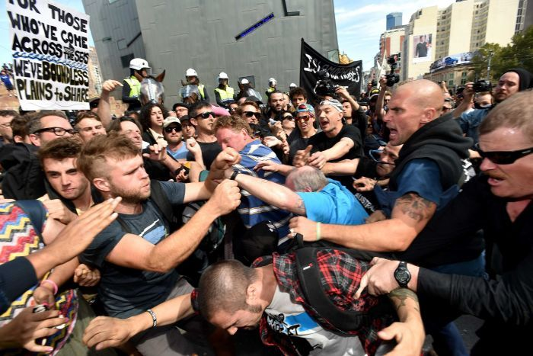
The Rise of intolerance
‘Reclaim Australia’ 2017

Slide 14
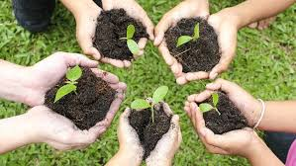

Slide 15
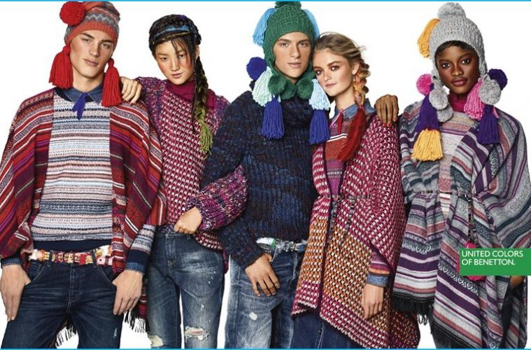

Slide 16
